Slide 1
INTERNET BANKING

Slide 2
Internet banking is a better use of banking where there is no need for an individual to go to bank for his transactions. We create entries to each customer in our database. We provide user credentials to individual accounts for safer use. It allows customers to monitor accounts, transactions, transfer funds between accounts, including checking, saving, and loan activity.
The first and foremost slogan of this system is to reduce most of the offline work.
Internet banking makes your life faster and easier.

Slide 3
Tasks Implemented :
Balance enquiry.
Funds Transfer between accounts in the same bank.
Request for cheque book/stop payment of Cheques.
Viewing recent transactions.
Profile settings.

Slide 4
Specific Technology :
MY SQL
HTML
CSS
PHP
.

Slide 5
WELCOME TO NORMALIZATION REPORT

Slide 6
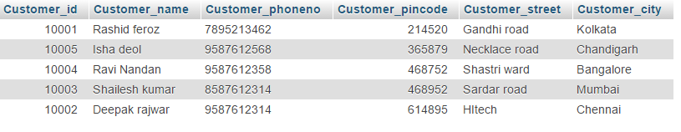
Customer relation before 1NF
Address Attribute
The Above Relation Contains Composite Attribute. So it not in 1NF.

Slide 7
Converting to 1NF by Decomposing Composite
Attribute ( Address ) into Single valued Attributes
(Customer_Street and Customer_City).
It is also in 2NF as every attribute is fully
functionally dependent on Primary Key.
Not in 3NF as Customer_id functionally determines Customer_Pincode and also Customer_pincode functionally Determines Customer_street and Customer_city.So they are decomposed accordingly

Slide 8
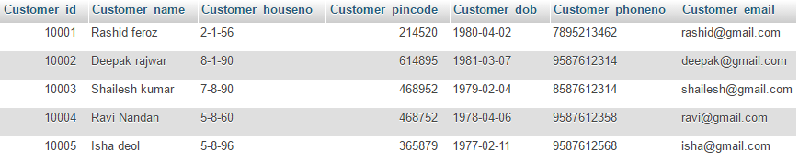
Customer Table
Normal Form : BCNF
Primary key : Customer_id
, Candidate key : Customer_email
Customer_id -> {Customer_name , Customer_houseno ,Customer_pincode , Customer_dob ,
Customer_phoneno ,Customer_email }
Customer_email -> {Customer_name , Customer_houseno ,Customer_pincode , Customer_dob ,
Customer_phoneno , Customer_id }

Slide 9
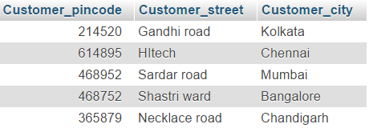
Pin Table
Normal Form : BCNF
Primary key : Customer_pincode
Customer_pincode -> {Customer_street , Customer_city}

Slide 10
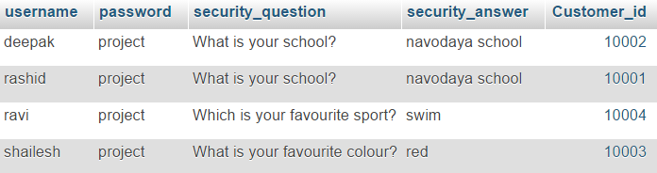
Login Table
Normal Form : BCNF
Primary key : username , Foreign key : Customer_id
Username -> {password , security_question , security_answer , Customer_id}
Customer_id -> {username , password , security_question , security_answer}

Slide 11
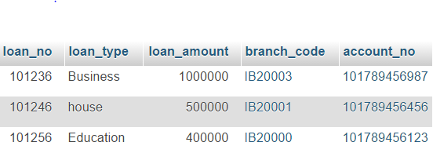
Loan Table
Normal Form : BCNF
Primary key : loan_no
Foreign keys : account_no , branch_code
loan_no -> {loan_type , loan_amount , account_no , branch_code}
account_no -> loan_no
account_no -> branch_code

Slide 12
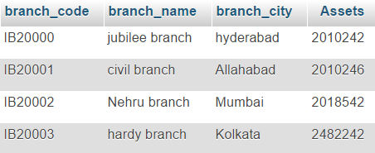
Branch Table
Normal Form : BCNF
Primary key : branch_code
branch_code -> {branch_name , branch_city , assets}

Slide 13
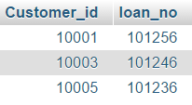
Borrower Table
Normal Form : BCNF
Foreign keys : Customer_id , loan_no
Customer_id -> loan_no
loan_no -> Customer_id

Slide 14
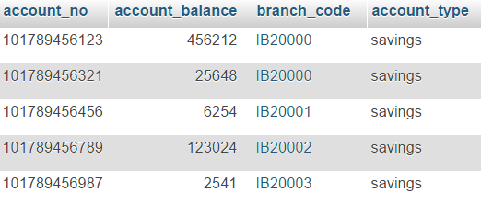
Account Table
Normal Form : BCNF
Primary key : account_no , Foreign key : branch_code
account_no -> {account_balance , account_type , branch_code}

Slide 15
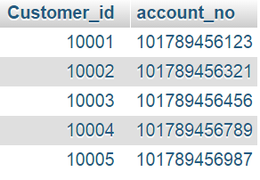
Depositor Table
Normal Form : BCNF
Foreign keys : Customer_id , account_no
Customer_id -> account_no
account_no -> Customer_id

Slide 16
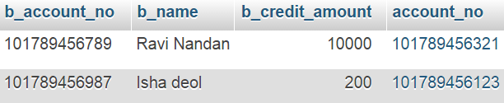
Beneficiary Table
Normal Form : BCNF
Primary key : b_account_no
Foreign key : account_no
b_account_no -> {b_name , b_credit_amount, account_no}

Slide 17
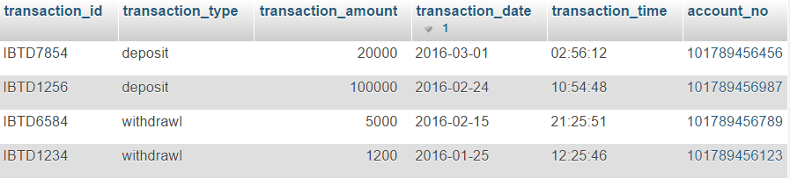
Transaction_Details Table
Normal Form : BCNF
Primary key : b_ transaction_id
Foreign key : account_no
transaction_id -> {transaction_type , transaction_amount , transaction_date ,
transaction_time , account_no}

Slide 18
Admin Table
Normal Form : BCNF
Primary key : admin_id
Candidate key : admin_username
admin_id -> { admin_name , admin_gender , admin_dob , admin_relationship , admin_address ,
admin_phone_no, admin_username , admin_password }
admin_username -> { admin_name , admin_gender , admin_dob , admin_relationship ,
admin_address, admin_phone_no, admin_password }

Slide 19
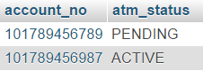
ATM Table
Normal Form : BCNF
Foreign key : account_no
account_no -> atm_status

Slide 20
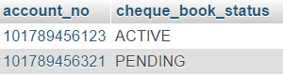
Cheque-Book Table
Normal Form : BCNF
Foreign key : account_no
account_no -> cheque_book_status

Slide 21
ER Diagram After Normalization

Slide 22
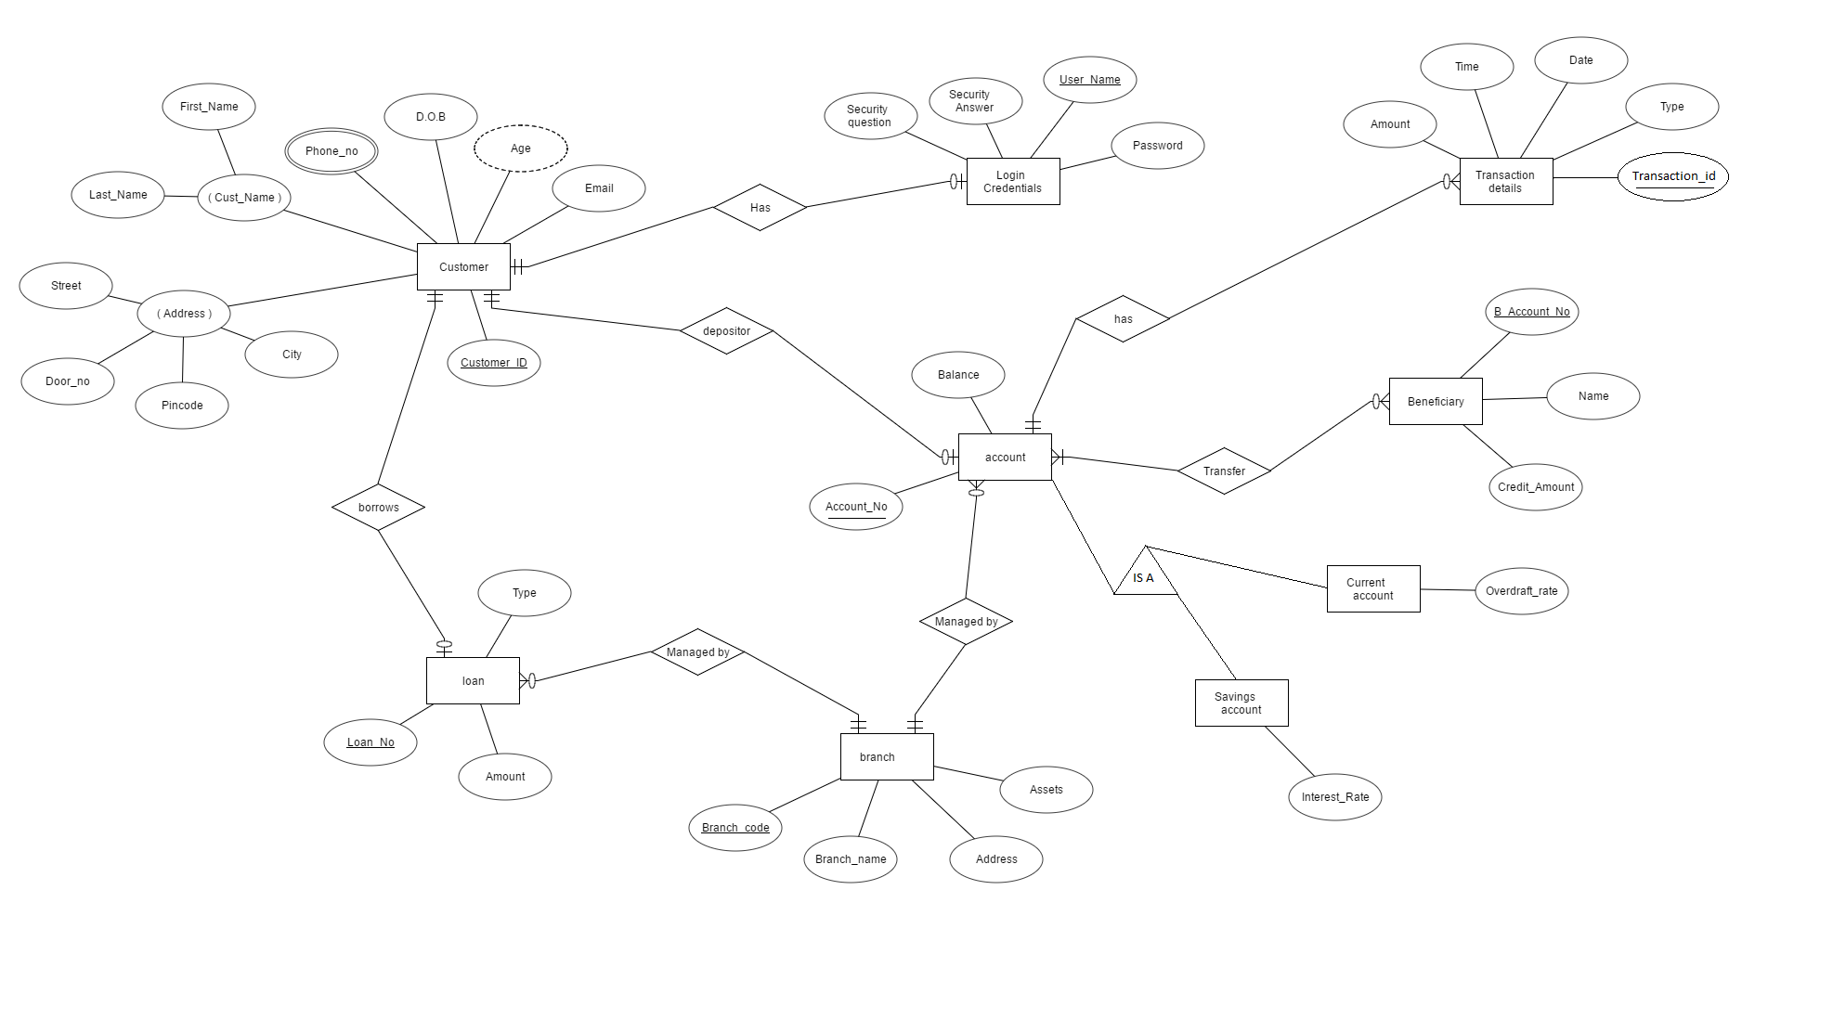

Slide 23
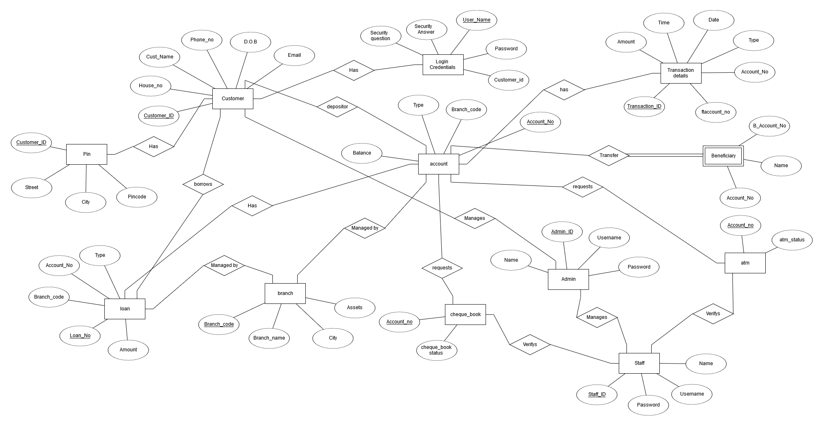

Slide 24
Our project includes
Handling Customers
Handling Staff
Handing Admin
Each one with their respective powers

Slide 25
Customer Forms

Slide 26


Slide 27
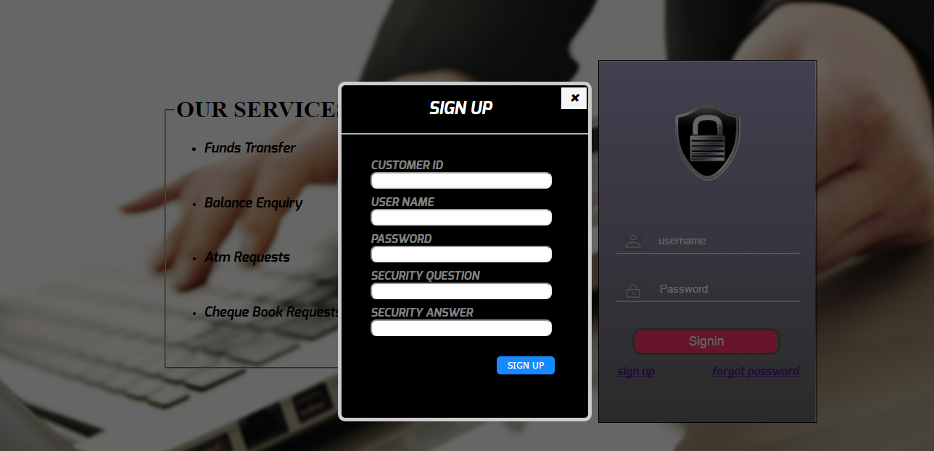

Slide 28
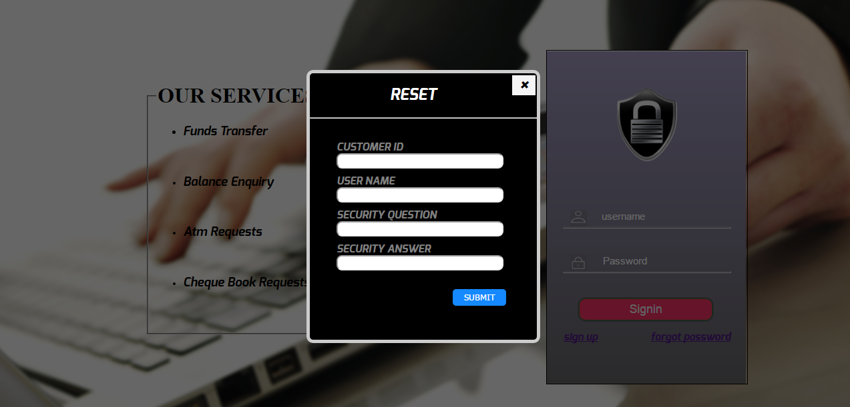

Slide 29
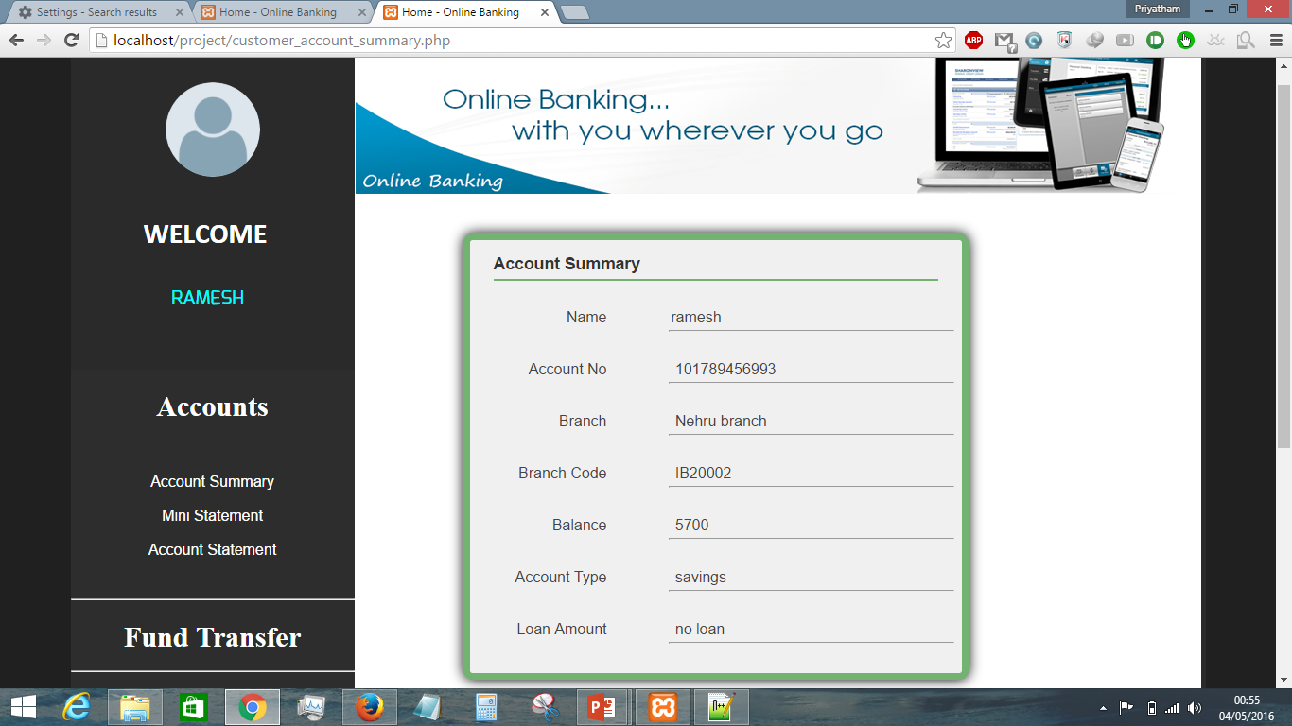

Slide 30
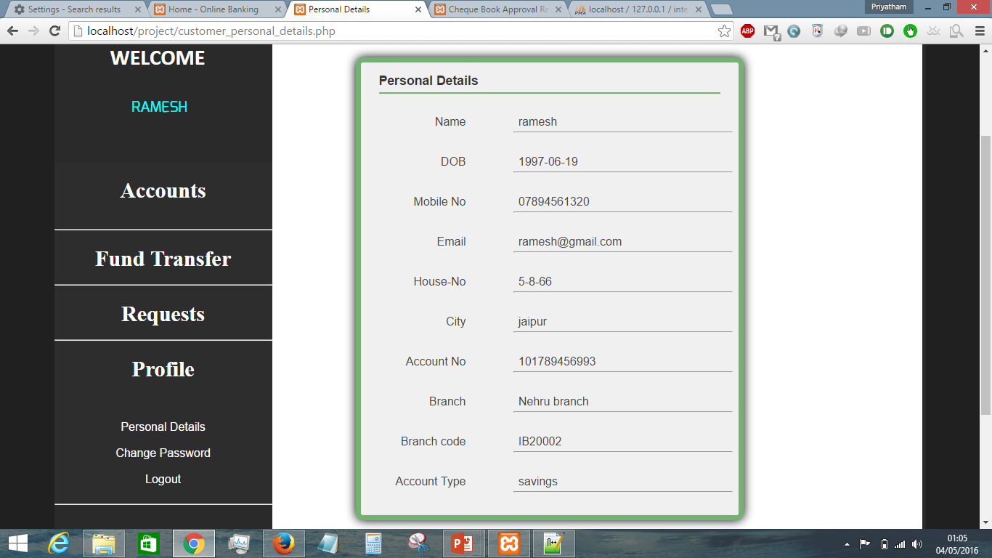

Slide 31
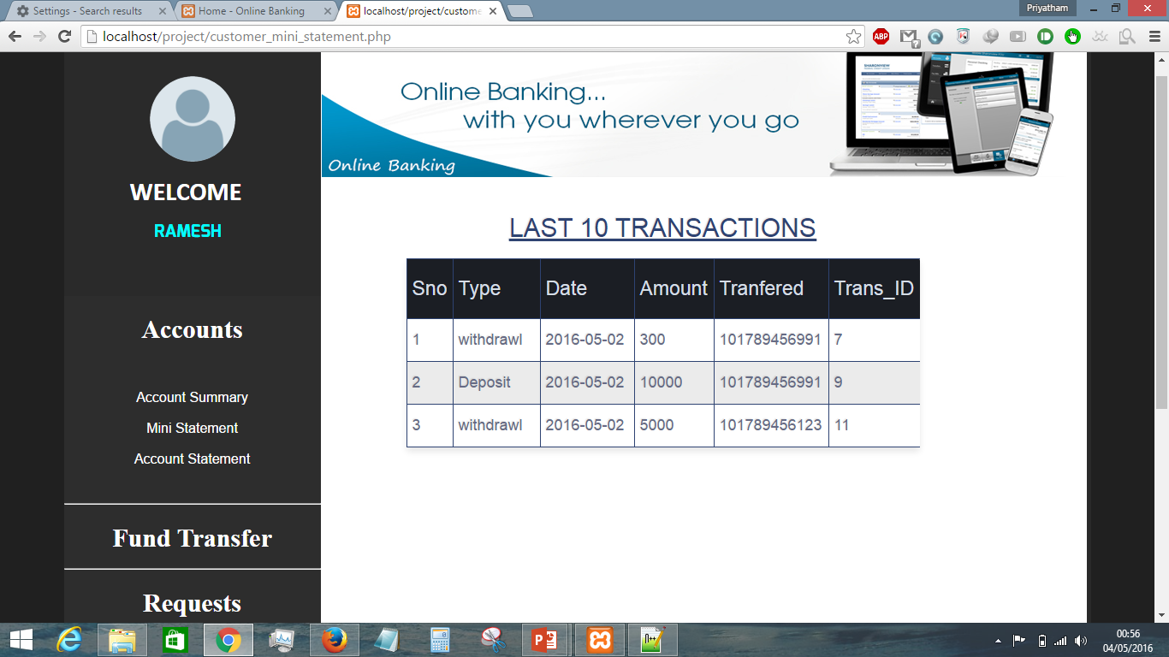

Slide 32
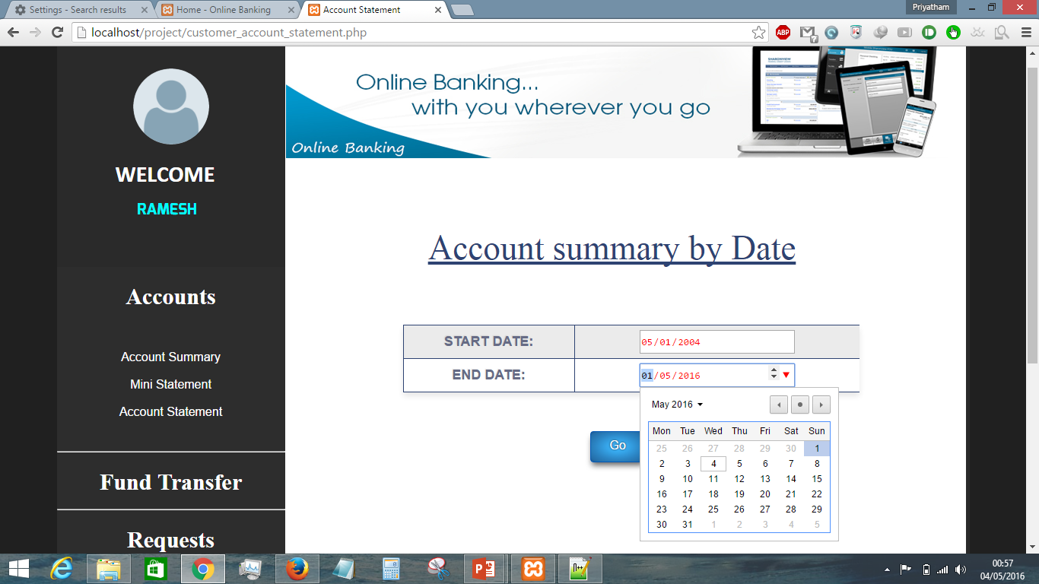

Slide 33
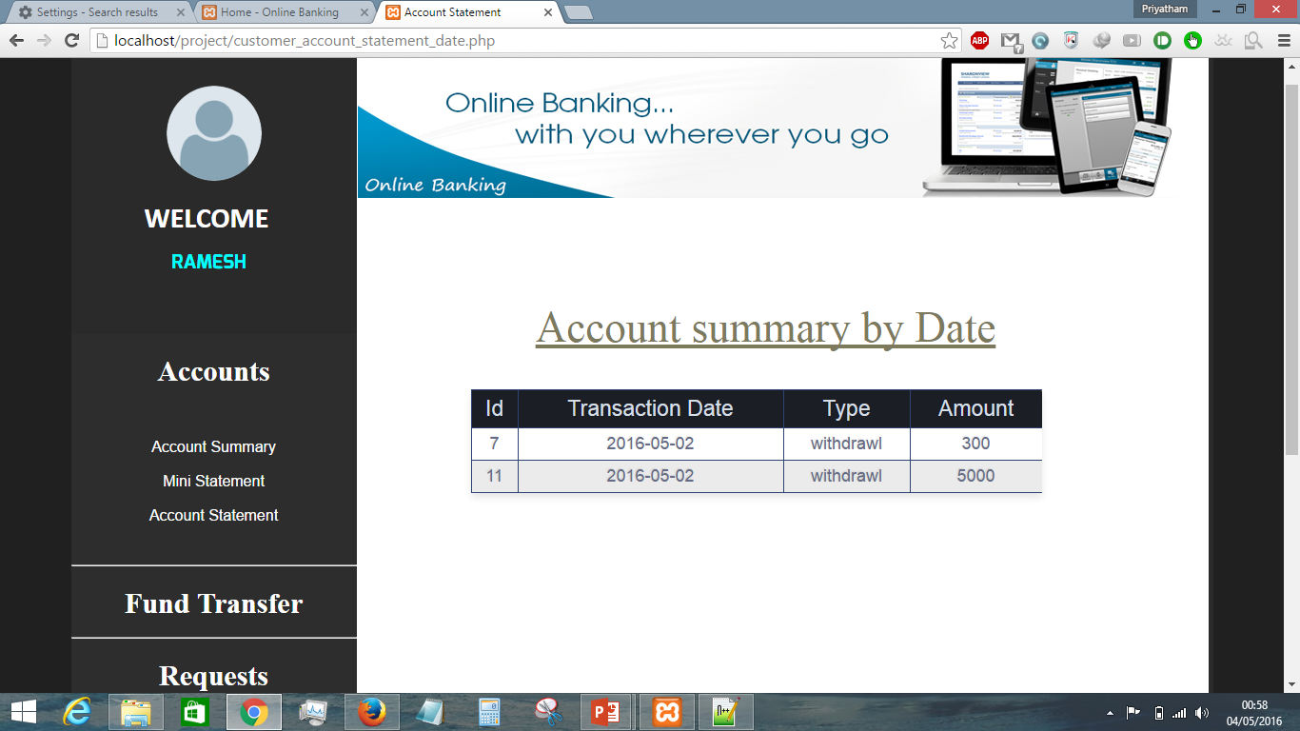

Slide 34
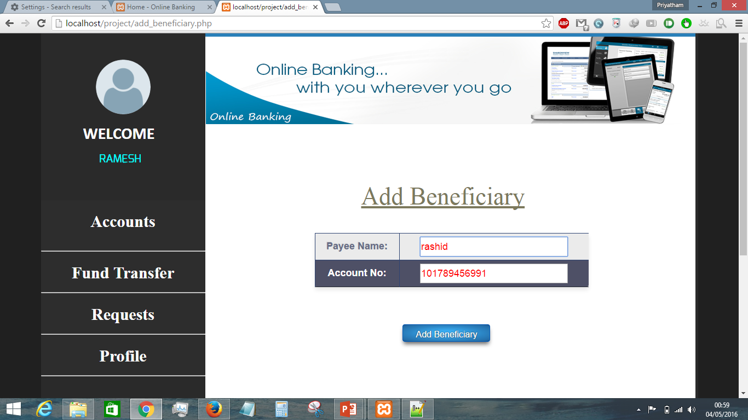

Slide 35
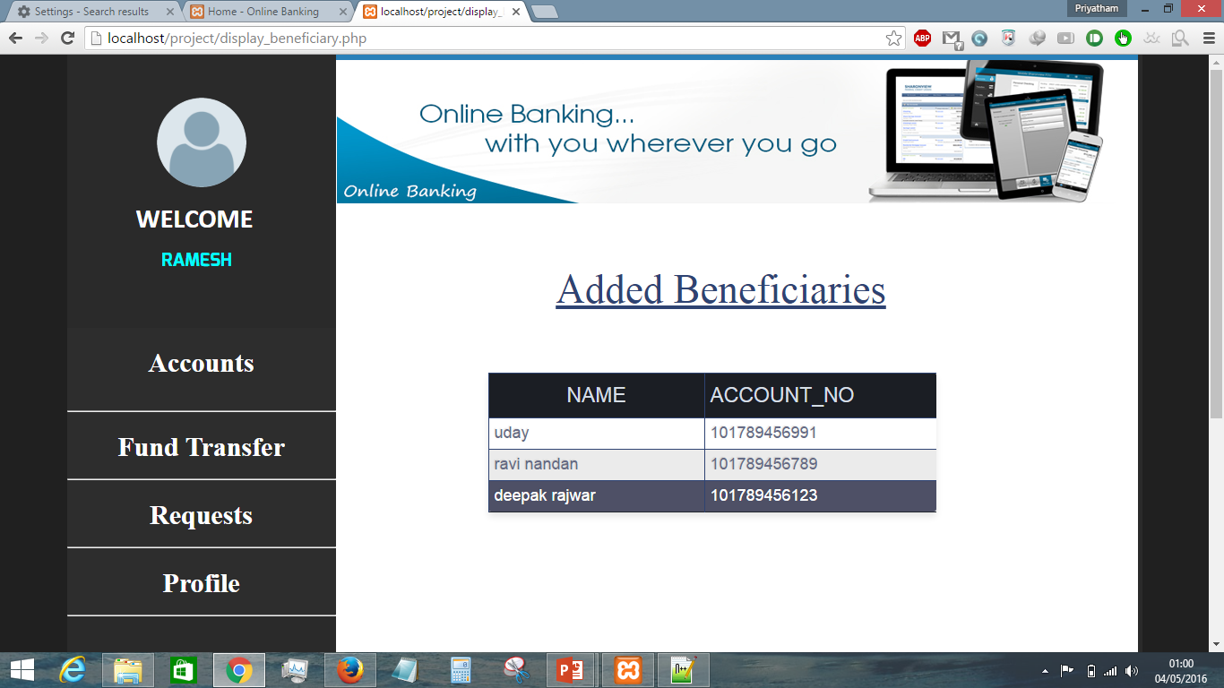

Slide 36
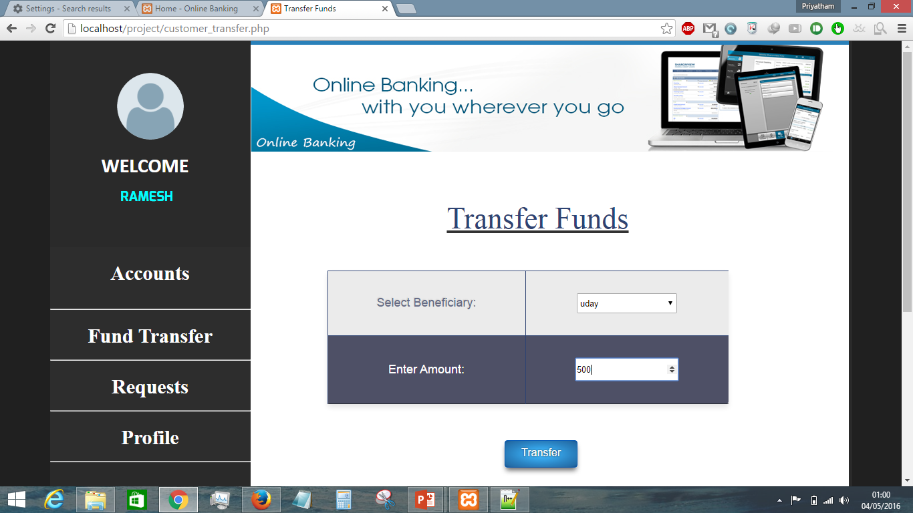

Slide 37
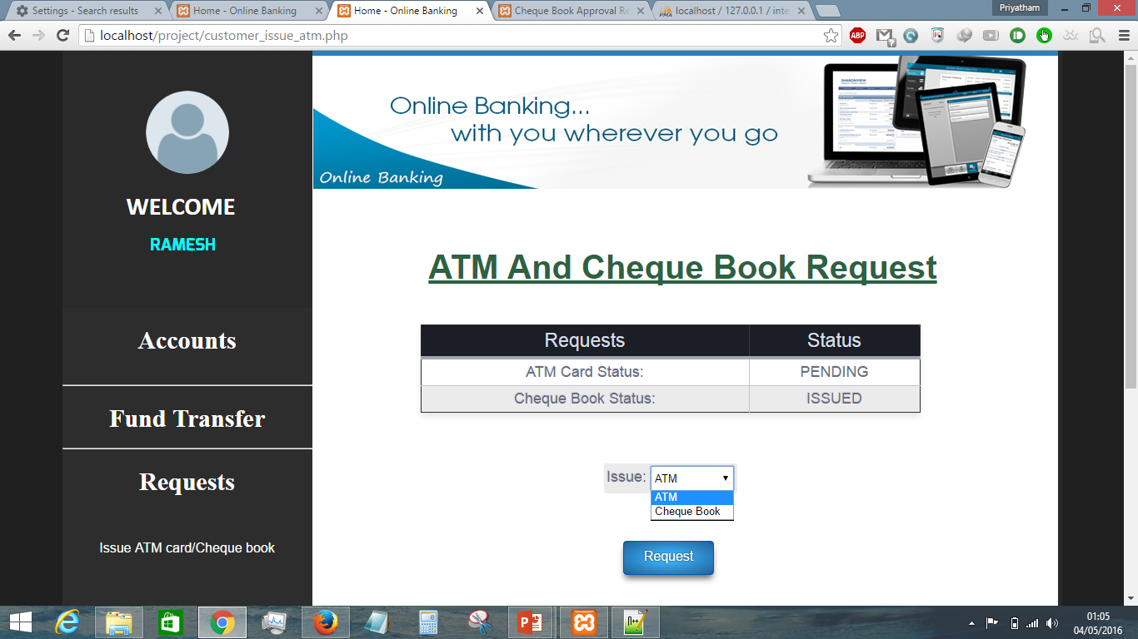

Slide 38
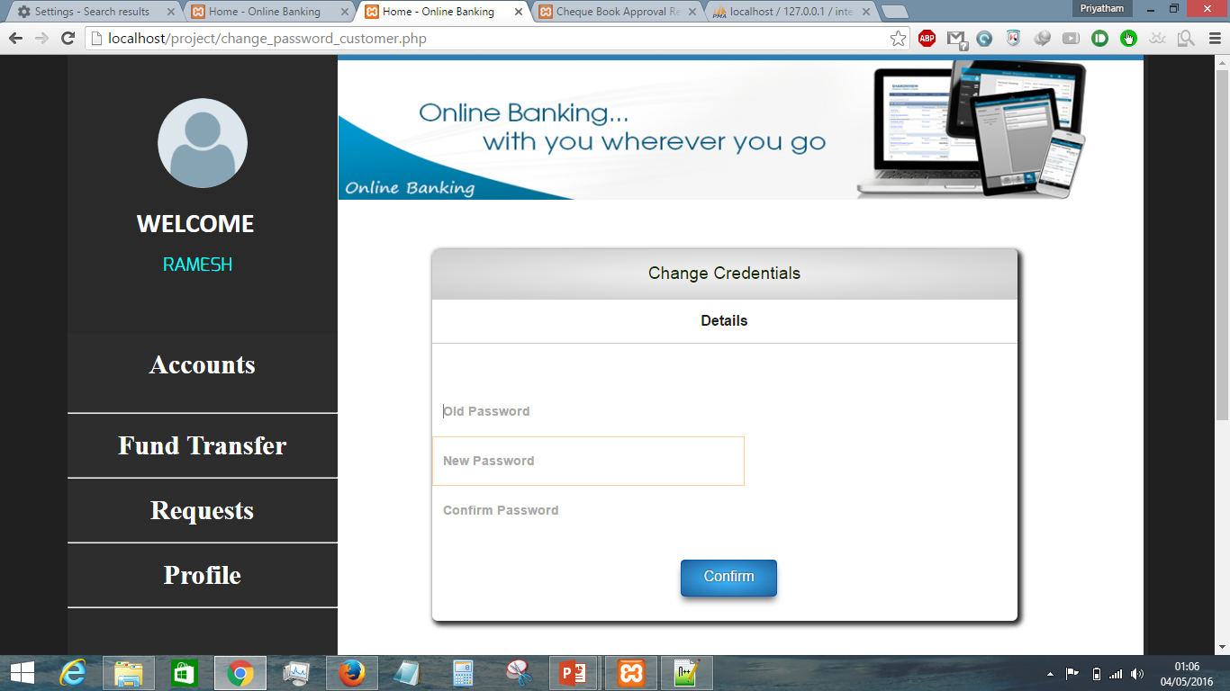

Slide 39
Staff Forms

Slide 40


Slide 41
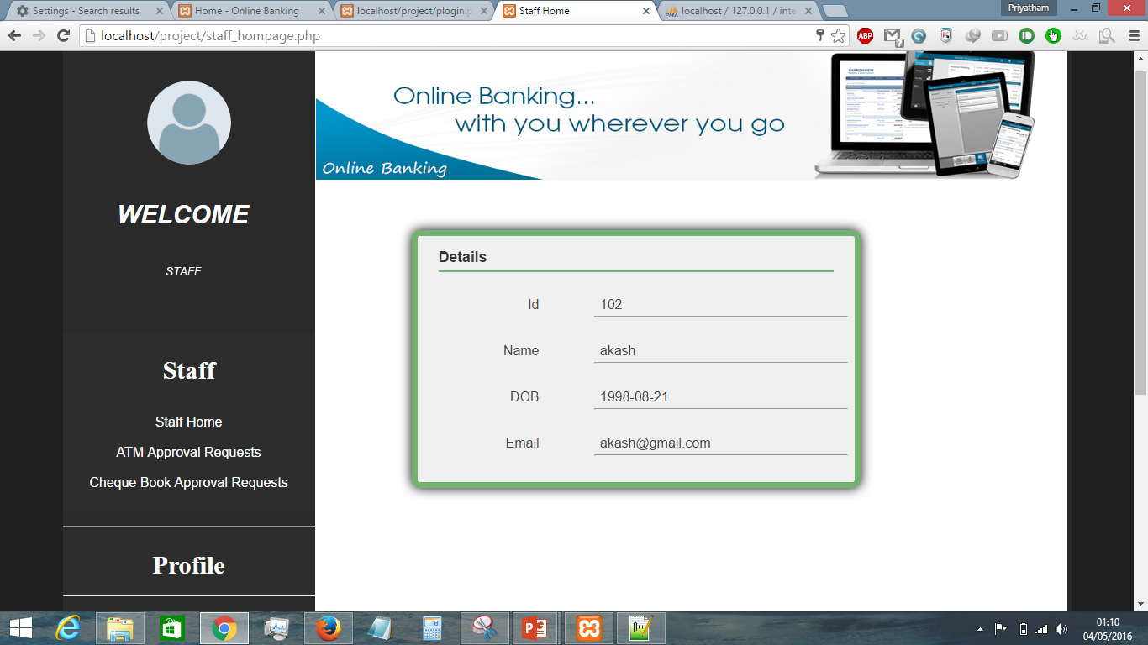

Slide 42
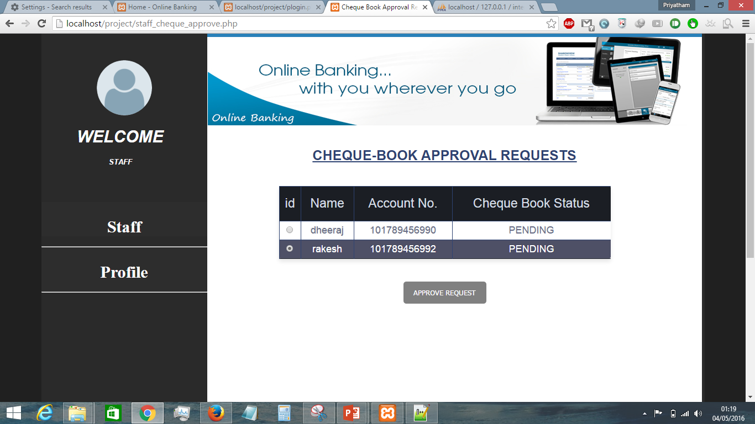

Slide 43
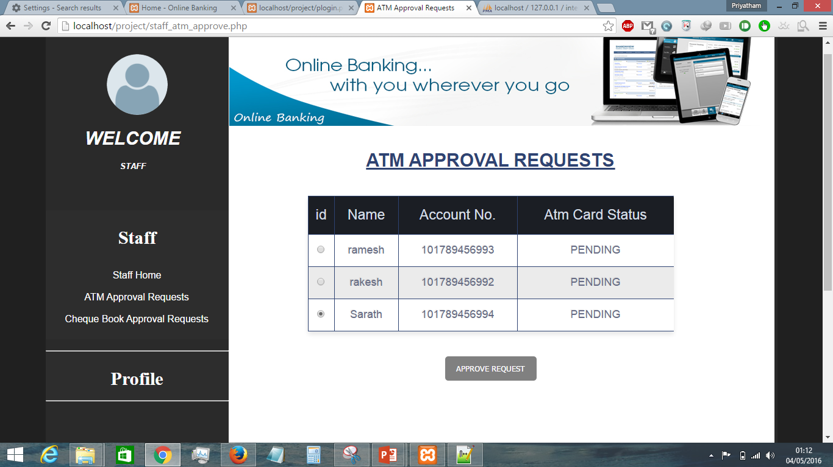

Slide 44
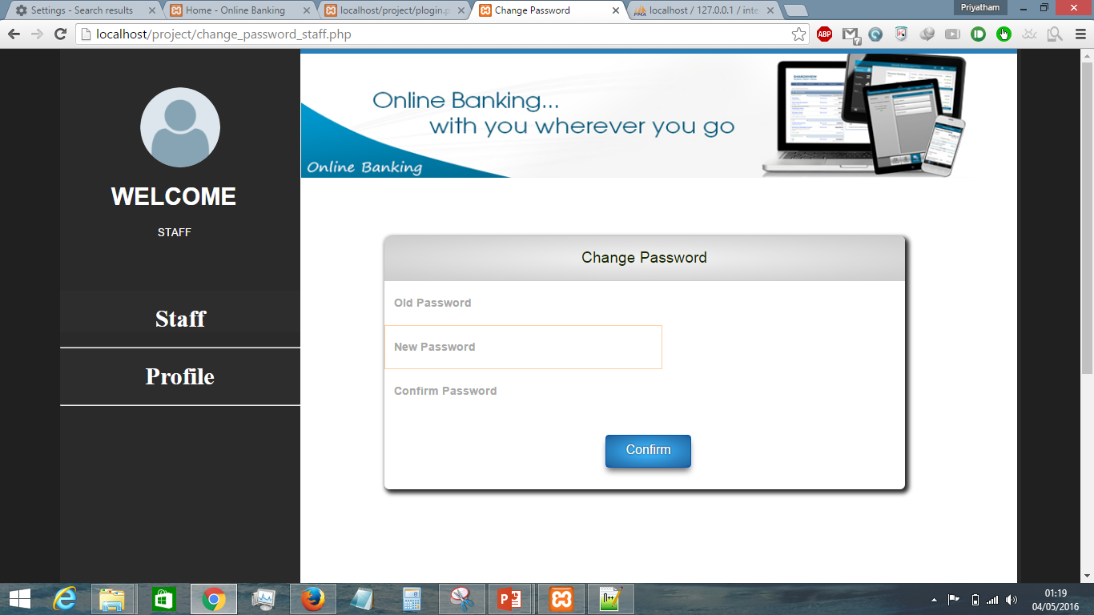

Slide 45
ADMIN FORMS

Slide 46


Slide 47
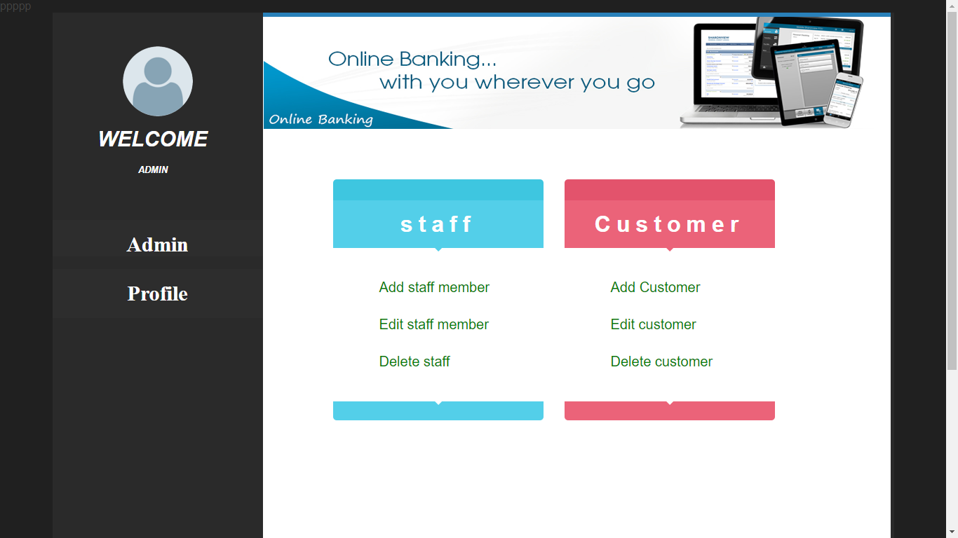

Slide 48
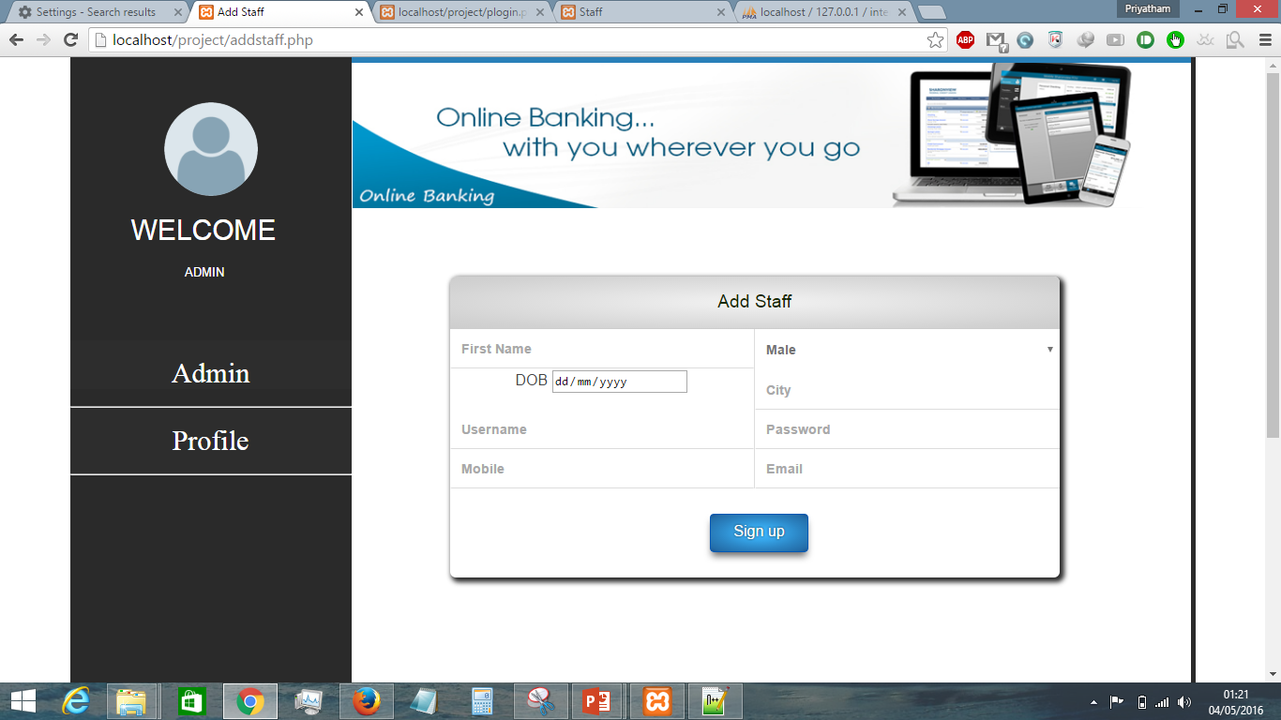

Slide 49
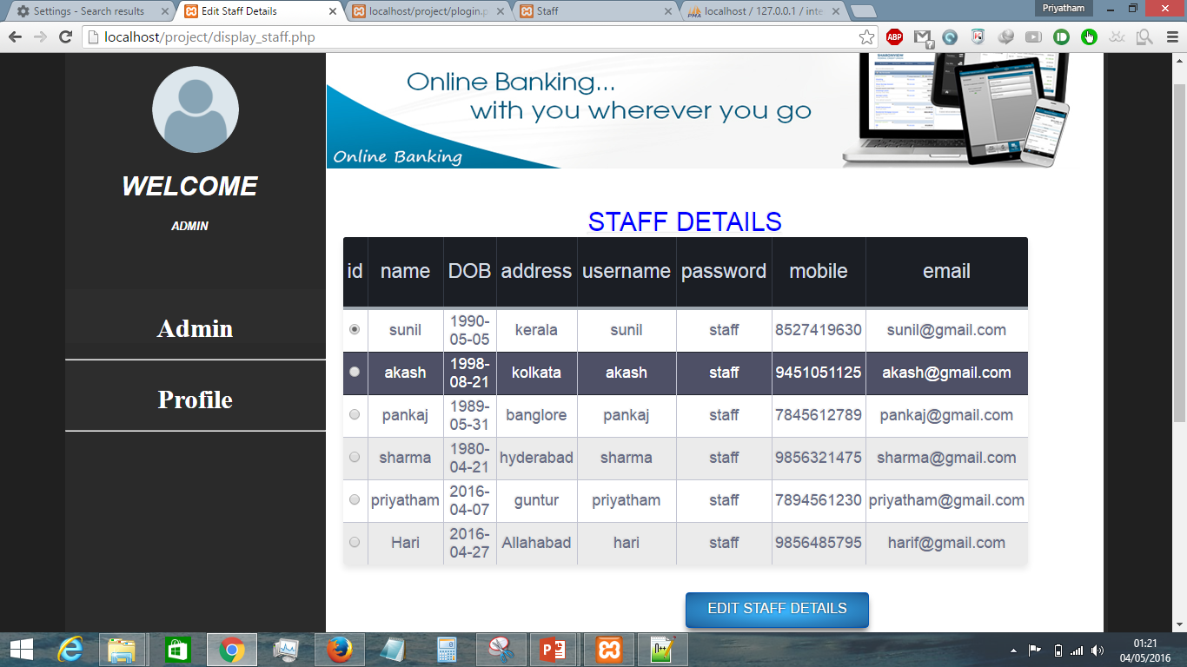

Slide 50
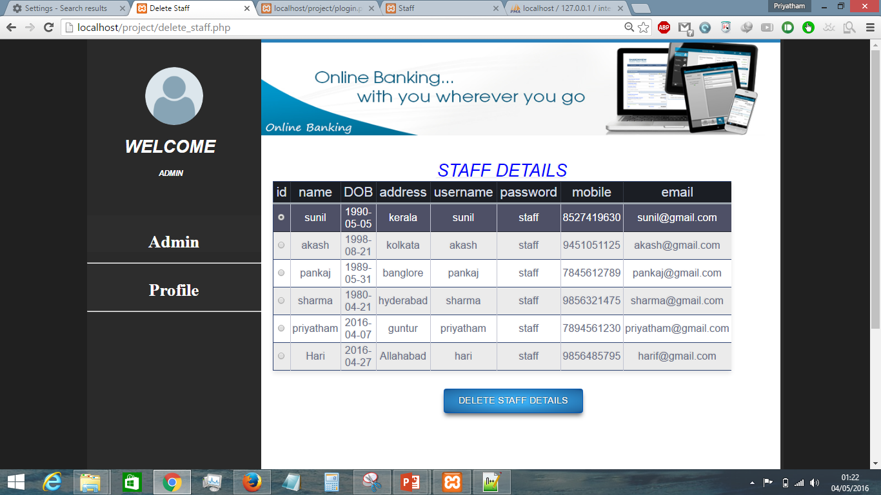

Slide 51


Slide 52
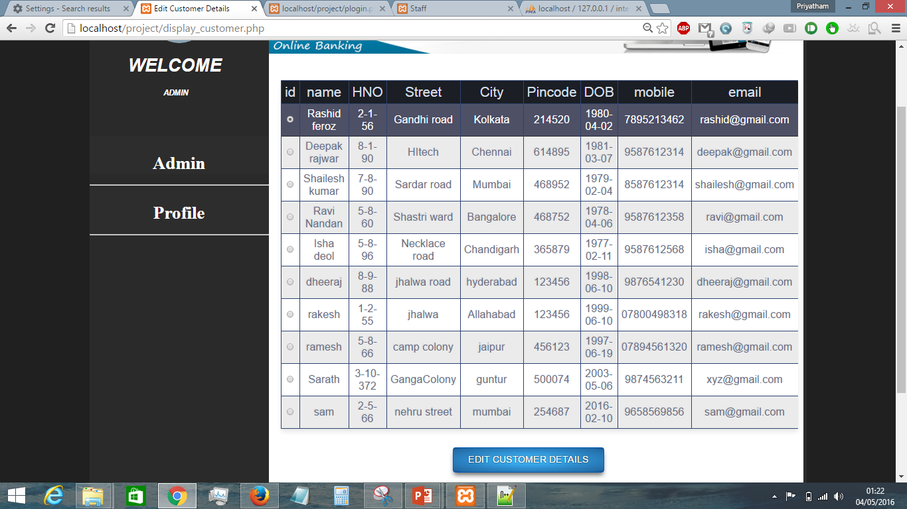

Slide 53
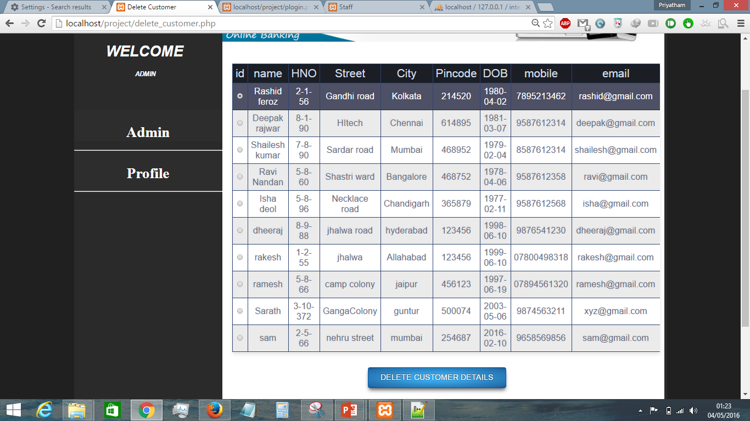

Slide 54
Thanking You

Slide 55
Members
IIT2014056
B.Sharath Chandra
IIT2014057
B.Priyatham
IIT2014078
N.Lavan Kumar
IIT2014113
K.Uday Kumar
IIT2014114
Ch.Sarath

Slide 56
For Queries and Compliments :
Contact :
B.Sharath : 9648212702 -> sharath1643@gmail.com
B.Priyatham : 7800498318 -> priyathamp4@gmail.com
N.Lavan : 9648206712 -> nalgondalavankumar@gmail.com
IIIT-Allahabad

